Slide 1

Network+ Guide to Networks 6th Edition
Network Security

Slide 2
Objectives
Identify security threats and vulnerabilities in LANs and WANs and design security policies that minimize risks
Explain security measures for network hardware and design, including firewalls, intrusion detection systems, and scanning tools
Understand methods of encryption, such as SSL and IPSec, that can secure data in storage and in transit

Slide 3
Objectives (cont’d.)
Describe how user authentication protocols, such as PKI, RADIUS, TACACS+, Kerberos, CHAP, MS-CHAP, and EAP function
Use network operating system techniques to provide basic security
Understand wireless security protocols, such as WEP, WPA, and 802.11i

Slide 4
Security Assessment
Examine network’s security risks
Consider effects
Different organization types
Different network security risk levels
Posture assessment
Thorough network examination
Determine possible compromise points
Performed in-house by IT staff
Performed by third party

Slide 5
Security Risks
Hacker
Individual who gains unauthorized access to systems
Vulnerability
Weakness of a system, process, or architecture
Exploit
Means of taking advantage of a vulnerability
Zero-day exploit
Taking advantage of undiscovered software vulnerability
Most vulnerabilities are well known

Slide 6
Risks Associated with People
Half of all security breaches
Human errors, ignorance, omissions
Social engineering
Strategy to gain password
Phishing
Glean access, authentication information
Pose as someone needing information
Many risks associated with people exist
Easiest way to circumvent network security
Take advantage of human error

Slide 7
Risks Associated with Transmission and Hardware
Physical, Data Link, and Network layer security risks
Require more technical sophistication
Risks inherent in network hardware and design
Transmission interception
Man-in-the-middle attack
Eavesdropping
Networks connecting to Internet via leased public lines
Sniffing
Repeating devices broadcast traffic over entire segment

Slide 8
Risks Associated with Transmission and Hardware (cont’d.)
Risks inherent in network hardware and design (cont’d.)
Port access via port scanner
Unused switch, router, server ports not secured
Private address availability to outside
Routers not properly configured to mask internal subnets
Router attack
Routers not configured to drop suspicious packets

Slide 9
Risks Associated with Transmission and Hardware (cont’d.)
Risks inherent in network hardware and design (cont’d.)
Access servers not secured, monitored
Computers hosting sensitive data:
May coexist on same subnet as public computers
Insecure passwords
Easily guessable or default values

Slide 10
Risks Associated with Protocols and Software
Includes Transport, Session, Presentation, and Application layers
Networking protocols and software risks
TCP/IP security flaws
Invalid trust relationships
NOS back doors, security flaws
Buffer overflow
NOS allows server operators to exit to command prompt
Administrators default security options
Intercepting transactions between applications

Slide 11
Risks Associated with Internet Access
Network security compromise
More often “from the inside”
Outside threats still very real
Web browsers permit scripts to access systems
Users provide information to sites

Slide 12
Risks Associated with Internet Access (cont’d.)
Common Internet-related security issues
Improperly configured firewall
Outsiders obtain internal IP addresses: IP spoofing
Telnets or FTPs
Transmit user ID and password in plain text
Newsgroups, mailing lists, forms
Provide hackers user information
Chat session flashing
Denial-of-service attack
Smurf attack: hacker issues flood of broadcast ping messages

Slide 13
An Effective Security Policy
Minimize break-in risk
Communicate with and manage users
Use thoroughly planned security policy
Security policy
Identifies security goals, risks, authority levels, designated security coordinator, and team members
Responsibilities of each employee
How to address security breaches
Not included in policy:
Hardware, software, architecture, and protocols
Configuration details

Slide 14
Security Policy Goals
Typical goals
Ensure authorized users have appropriate resource access
Prevent unauthorized user access
Protect unauthorized sensitive data access
Inside and outside
Prevent accidental hardware and software damage
Prevent intentional hardware or software damage
Create secure environment
Withstand, respond to, and recover from threat
Communicate employees’ responsibilities

Slide 15
Security Policy Goals (cont’d.)
Strategy
Form committee
Involve as many decision makers as possible
Assign security coordinator to drive policy creation
Understand risks
Conduct posture assessment
Rate severity and likelihood of each threat
Assign person responsible for addressing threats

Slide 16
Security Policy Content
Outline policy content
Define policy subheadings
Explain to users:
What they can and cannot do
How measures protect network’s security
User communication
Security newsletter
User security policy section
Define what confidential means to the organization

Slide 17
Response Policy
Security breach occurrence
Provide planned response
Identify response team members
Understand security policy, risks, and measures in place
Accept role with certain responsibilities
Regularly rehearse defense
Threat drill

Slide 18
Response Policy (cont’d.)
Suggested team roles
Dispatcher
Person on call; first to notice; alerted to problem
Manager
Coordinates resources
Technical support specialist
One focus: solve problem quickly
Public relations specialist
Official spokesperson to public
After problem resolution
Review process

Slide 19
Physical Security
Restrict physical access to network components
Lock computer rooms, telco rooms, wiring closets, and equipment cabinets
Locks can be physical or electronic
Electronic access badges
Locks requiring entrants to punch numeric code
Bio-recognition access

Slide 20
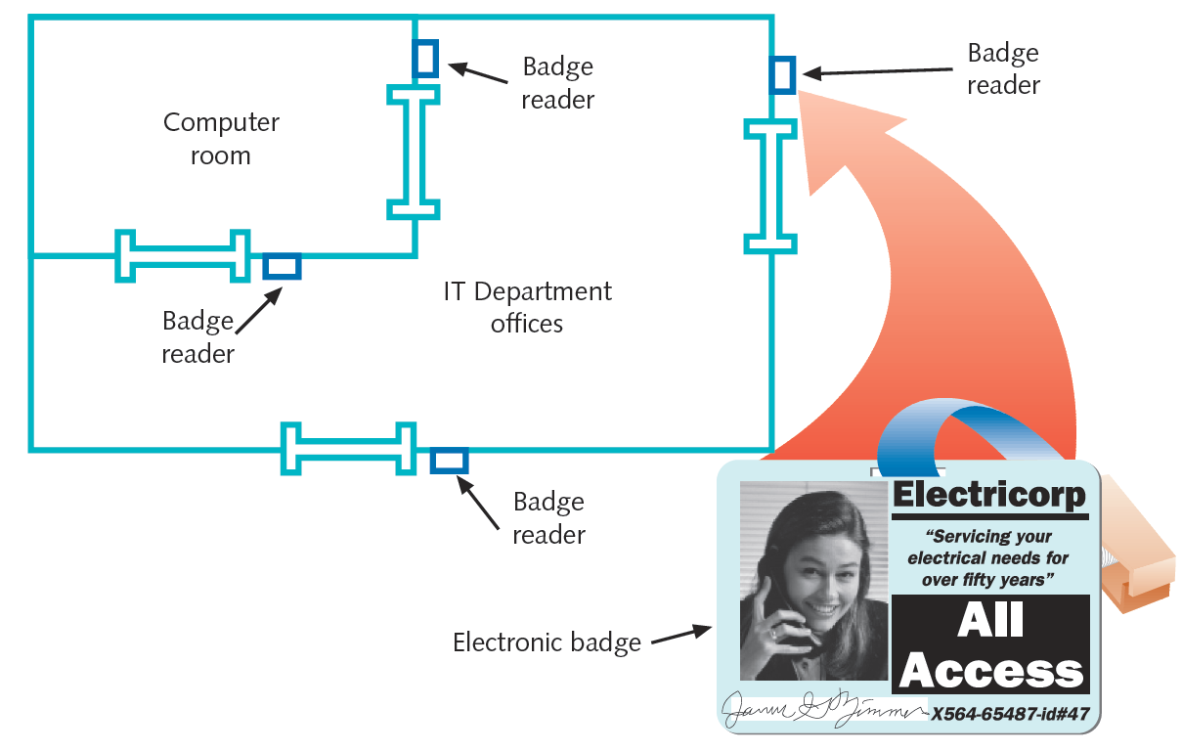
Figure 11-1 Badge access security system
Courtesy Course Technology/Cengage Learning

Slide 21
Physical Security (cont’d.)
Physical barriers
Gates, fences, walls, and landscaping
Closed-circuit TV systems monitor secured rooms
Surveillance cameras
Data centers, telco rooms, data storage areas, facility entrances
Central security office capabilities
Display several camera views at once
Switch from camera to camera
Video footage used in investigation and prosecution

Slide 22
Physical Security (cont’d.)
Security audit
Ask questions related to physical security checks
Consider losses from salvaged and discarded computers
Hard disk information stolen
Solutions
Run specialized disk sanitizer program
Remove disk and use magnetic hard disk eraser
Pulverize or melt disk

Slide 23
Security in Network Design
Breaches may occur due to poor LAN or WAN design
Address though intelligent network design
Preventing external LAN security breaches
Restrict access at every point where LAN connects to rest of the world

Slide 24
Router Access Lists
Control traffic through routers
Router’s main functions
Examine packets
Determine destination
Based on Network layer addressing information
ACL (access control list)
Also called access list
Routers can decline to forward certain packets

Slide 25
Router Access Lists (cont’d.)
ACL variables used to permit or deny traffic
Network layer protocol (IP, ICMP)
Transport layer protocol (TCP, UDP)
Source IP address
Source netmask
Destination IP address
Destination netmask
TCP or UDP port number

Slide 26
Router Access Lists (cont’d.)
Router receives packet, examines packet
Refers to ACL for permit, deny criteria
Drops packet if deny characteristics match
Forwards packet if permit characteristics match
Access list statement examples
Deny all traffic from source address with netmask 255.255.255.255
Deny all traffic destined for TCP port 23
Separate ACL’s for:
Interfaces; inbound and outbound traffic

Slide 27
Intrusion Detection and Prevention
Proactive security measure
Detecting suspicious network activity
IDS (intrusion detection system)
Software monitoring traffic
On dedicated IDS device
On another device performing other functions
Port mirroring
One port makes copy of traffic to second port for monitoring

Slide 28
Intrusion Detection and Prevention (cont’d.)
IDS software detects many suspicious traffic patterns
Examples: denial-of-service, smurf attacks
DMZ (demilitarized zone)
Network’s protective perimeter
IDS sensors installed at network edges
IDS at DMZ drawback
Number of false positives logged
IDS can only detect and log suspicious activity

Slide 29
Intrusion Detection and Prevention (cont’d.)
IPS (intrusion-prevention system)
Reacts to suspicious activity when alerted
Detects threat and prevents traffic from flowing to network
Based on originating IP address
NIPS (network-based intrusion prevention)
Protects entire networks
HIPS (host-based intrusion prevention)
Protects certain hosts

Slide 30
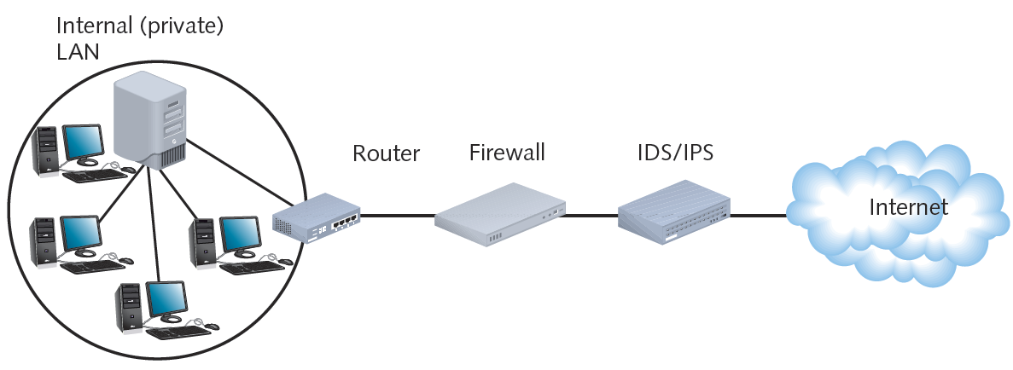
Figure 11-2 Placement of an IDS/IPS on a network
Courtesy Course Technology/Cengage Learning

Slide 31
Firewalls
Specialized device or computer installed with specialized software
Selectively filters and blocks traffic between networks
Involves hardware and software combination
Firewall location
Between two interconnected private networks
Between private network and public network (network-based firewall)

Slide 32
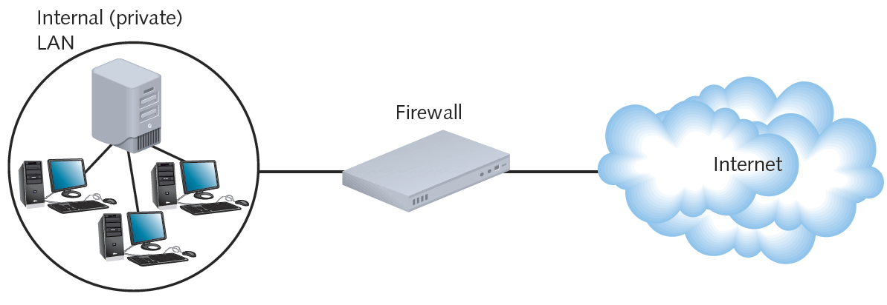
Figure 11-3 Placement of a firewall between a private network and the Internet
Courtesy Course Technology/Cengage Learning

Slide 33
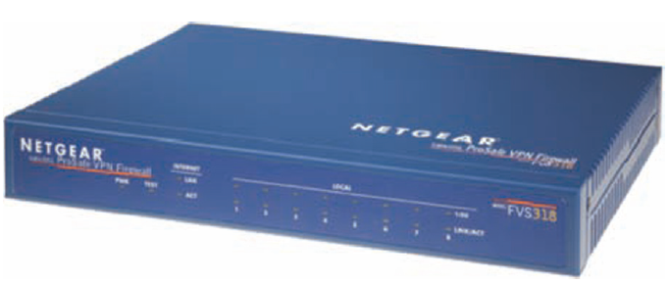
Figure 11-4 Firewall
Courtesy of NETGEAR

Slide 34
Firewalls (cont’d.)
Packet-filtering firewall
Simplest firewall
Examines header of every entering packet
Can block traffic entering or exiting a LAN
Firewall default configuration
Blocks most common security threats
Preconfigured to accept and deny certain traffic types
Network administrators often customize settings

Slide 35
Firewalls (cont’d.)
Common packet-filtering firewall criteria
Source, destination IP addresses
Source, destination ports
Flags set in the IP header
Transmissions using UDP or ICMP protocols
Packet’s status as first packet in new data stream, subsequent packet
Packet’s status as inbound to, outbound from private network

Slide 36
Firewalls (cont’d.)
Port blocking
Prevents connection to and transmission completion through ports
Optional firewall functions
Encryption
User authentication
Central management
Easy rule establishment
Filtering based on data contained in packets

Slide 37
Firewalls (cont’d.)
Optional firewall functions (cont’d.)
Logging, auditing capabilities
Protect internal LAN’s address identity
Monitor data stream from end to end (stateful firewall)
Tailoring a firewall
Consider type of traffic to filter
Consider exceptions to rules
Packet-filtering firewalls
Cannot distinguish user trying to breach firewall from authorized user

Slide 38
Proxy Servers
Proxy service
Network host software application
Intermediary between external and internal networks
Screens all incoming and outgoing traffic
Proxy server
Network host running proxy service
Also called application layer gateway, application gateway, proxy
Manages security at Application layer

Slide 39
Proxy Servers (cont’d.)
Fundamental function
Prevent outside world from discovering internal network addresses
Improves performance for external users
File caching

Slide 40
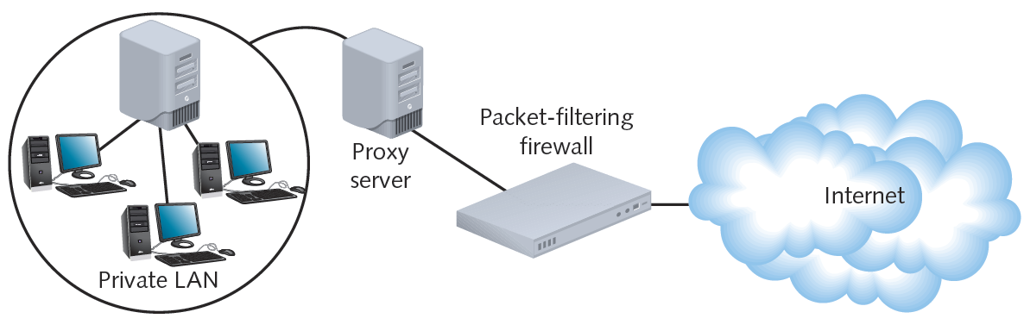
Figure 11-5 A proxy server used on a WAN
Courtesy Course Technology/Cengage Learning

Slide 41
Scanning Tools
Used during posture assessment
Duplicate hacker methods
NMAP (Network Mapper)
Designed to scan large networks
Provides information about network and hosts
Free to download
Nessus
Performs more sophisticated scans than NMAP

Slide 42
Lures
Honeypot
Decoy system that is purposefully vulnerable
Designed to fool hackers and gain information about their behavior
Honeynet
Network of honeypots

Slide 43
NOS (Network Operating System) Security
Restrict user authorization
Access to server files and directories
Public rights
Conferred to all users
Very limited
Group users according to security levels
Assign additional rights

Slide 44
Logon Restrictions
Additional restrictions to strengthen security
Time of day
Total time logged on
Source address
Unsuccessful logon attempts

Slide 45
Passwords
Choosing secure password
Guards against unauthorized access
Easy, inexpensive
Communicate password guidelines
Use security policy
Stress importance of company’s financial, personnel data security

Slide 46
Passwords (cont’d.)
Tips
Change system default passwords
Do not use familiar information or dictionary words
Dictionary attack
Use long passwords
Letters, numbers, special characters
Do not write down or share
Change frequently
Do not reuse
Use different passwords for different applications

Slide 47
Encryption
Use of algorithm to scramble data
Format read by algorithm reversal (decryption)
Designed to keep information private
Many encryption forms exist
Provides assurances
Data not modified between being sent and received
Data can be viewed only by intended recipient
Data was not forged by an intruder

Slide 48
Key Encryption
Key
Random string of characters
Woven into original data’s bits
Generates unique data block
Ciphertext
Scrambled data block
Brute force attack
Attempt to discover key
Trying numerous possible character combinations

Slide 49
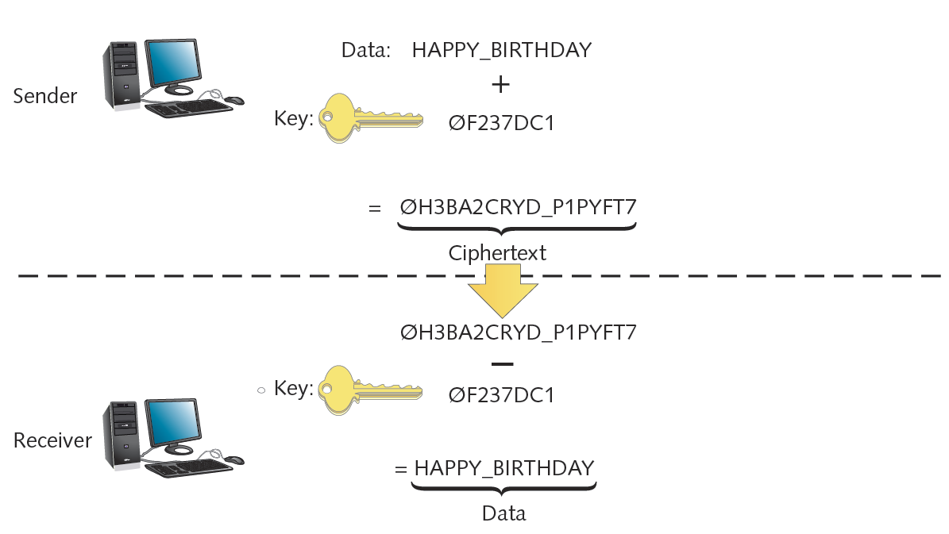
Figure 11-6 Key encryption and decryption
Courtesy Course Technology/Cengage Learning

Slide 50
Key Encryption (cont’d.)
Private key encryption
Data encrypted using single key
Known only by sender and receiver
Symmetric encryption
Same key used during both encryption and decryption
DES (Data Encryption Standard)
Most popular private key encryption
IBM developed (1970s)
56-bit key: secure at the time
Triple DES
Weaves 56-bit key three times

Slide 51
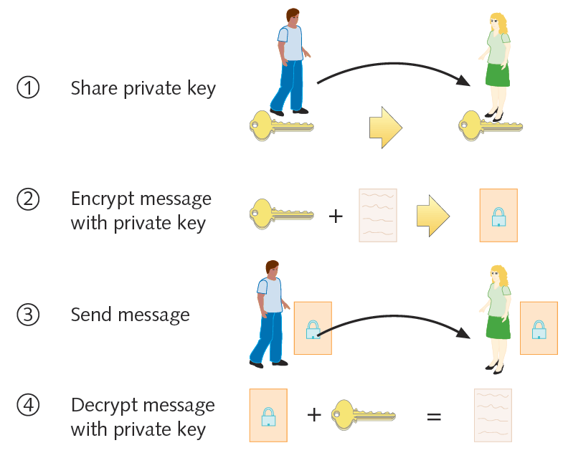
Figure 11-7 Private key encryption
Courtesy Course Technology/Cengage Learning

Slide 52
Key Encryption (cont’d.)
AES (Advanced Encryption Standard)
Weaves 128, 160, 192, 256 bit keys through data multiple times
Popular form uses Rijndael algorithm
More secure than DES
Much faster than Triple DES
Replaced DES in high security level situations
Private key encryption drawback
Sender must somehow share key with recipient

Slide 53
Key Encryption (cont’d.)
Public key encryption
Data encrypted using two keys
Private key: user knows
Public key: anyone may request
Public key server
Publicly accessible host
Freely provides users’ public keys
Key pair
Combination of public key and private key
Asymmetric encryption
Requires two different keys

Slide 54
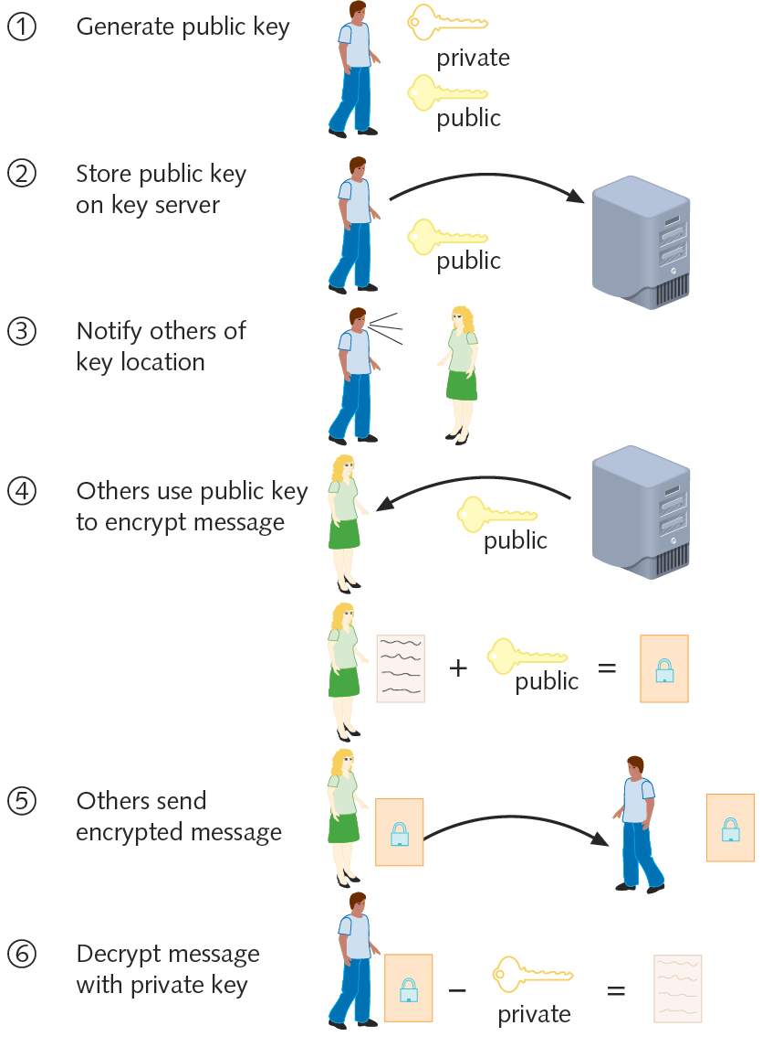
Figure 11-8 Public key encryption
Courtesy Course Technology/Cengage Learning

Slide 55
Key Encryption (cont’d.)
Diffie-Hellman (1975)
First public key algorithm
RSA
Most popular
Key creation
Choose two large prime numbers, multiplying together
May be used in conjunction with RC4
Weaves key with data multiple times, as computer issues data stream

Slide 56
Key Encryption (cont’d.)
RC4
Key up to 2048 bits long
Highly secure and fast
Digital certificate
Password-protected, encrypted file
Holds identification information
Includes public key

Slide 57
Key Encryption (cont’d.)
CA (certificate authority)
Issues, maintains digital certificates
Example: Verisign
PKI (public key infrastructure)
Use of certificate authorities to associate public keys with certain users

Slide 58
PGP (Pretty Good Privacy)
Secures e-mail transmissions
Developed by Phil Zimmerman (1990s)
Public key encryption system
Verifies e-mail sender authenticity
Encrypts e-mail data in transmission
Administered at MIT
Freely available
Open source and proprietary
Also used to encrypt storage device data

Slide 59
SSL (Secure Sockets Layer)
Encrypts TCP/IP transmissions
Web pages and Web form data between client and server
Uses public key encryption technology
Web pages using HTTPS
HTTP over Secure Sockets Layer, HTTP Secure
Data transferred from server to client (vice versa) using SSL encryption
HTTPS uses TCP port 443

Slide 60
SSL (cont’d.)
SSL session
Association between client and server
Defined by agreement
Specific set of encryption techniques
Created by SSL handshake protocol
Handshake protocol
Allows client and server to authenticate
SSL
Netscape originally developed
IETF attempted to standardize
TLS (Transport Layer Security) protocol

Slide 61
SSH (Secure Shell)
Collection of protocols
Provides Telnet capabilities with security
Guards against security threats
Unauthorized host access
IP spoofing
Interception of data in transit
DNS spoofing
Encryption algorithm (depends on version)
DES, Triple DES, RSA, Kerberos, others

Slide 62
SSH (cont’d.)
Developed by SSH Communications Security
Version requires license fee
Open source versions available: OpenSSH
Secure connection requires SSH running on both machines
Requires public and private key generation
Configuration options
Use one of several encryption types
Require client password
Perform port forwarding

Slide 63
SCP (Secure CoPy) and SFTP (Secure File Transfer Protocol)
SCP (Secure CoPy) utility
Extension to OpenSSH
Allows copying of files from one host to another securely
Replaces insecure file copy protocols (FTP)
Included with UNIX, Linux, and Macintosh OS X operating systems
Windows operating systems
Some SSH programs include SCP utility
Separate freeware SCP application: WinSCP

Slide 64
IPSec (Internet Protocol Security)
Defines encryption, authentication, key management for TCP/IP transmissions
Enhancement to IPv4
Native IPv6 standard
Difference from other methods
Encrypts data
Adds security information to all IP packet headers
Transforms data packets
Operates at Network layer (Layer 3)

Slide 65
IPSec (cont’d.)
Two phase authentication
Key management
Two nodes agree on common parameters for key use
IKE (Internet Key Exchange)
Encryption
AH (authentication header)
ESP (Encapsulating Security Payload)
Used with any TCP/IP transmission
Most commonly runs on routers, connectivity devices in VPN context

Slide 66
IPSec (cont’d.)
VPN concentrator
Specialized device
Positioned at private network edge
Establishes VPN connections
Authenticates VPN clients
Establish tunnels for VPN connections

Slide 67
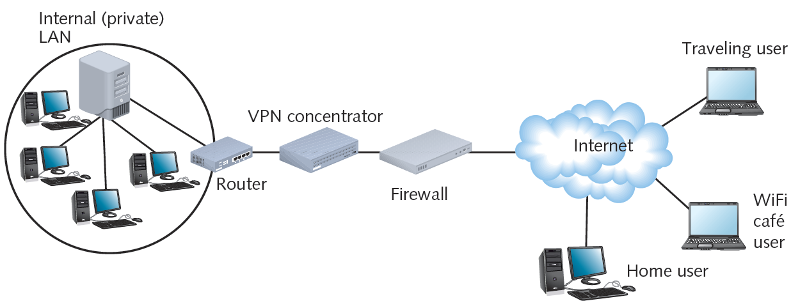
Figure 11-9 Placement of a VPN concentrator on a WAN
Courtesy Course Technology/Cengage Learning

Slide 68
Authentication Protocols
Authentication
Process of verifying user’s credentials
Grant user access to secured resources
Authentication protocols
Rules computers follow to accomplish authentication
Several authentication protocol types
Vary by encryption scheme:
And steps taken to verify credentials

Slide 69
RADIUS and TACACS+
Centralized service
Often used to manage resource access
AAA (authentication, authorization, and accounting)
Category of protocols that provide service
Establish client’s identity
Examine credentials and allow or deny access
Track client’s system or network usage

Slide 70
RADIUS and TACACS+ (cont’d.)
RADIUS (Remote Authentication Dial-In User Service)
Defined by the IETF
Runs over UDP
Can operate as application on remote access server
Or on dedicated RADIUS server
Highly scalable
May be used to authenticate wireless connections
Can work in conjunction with other network servers

Slide 71
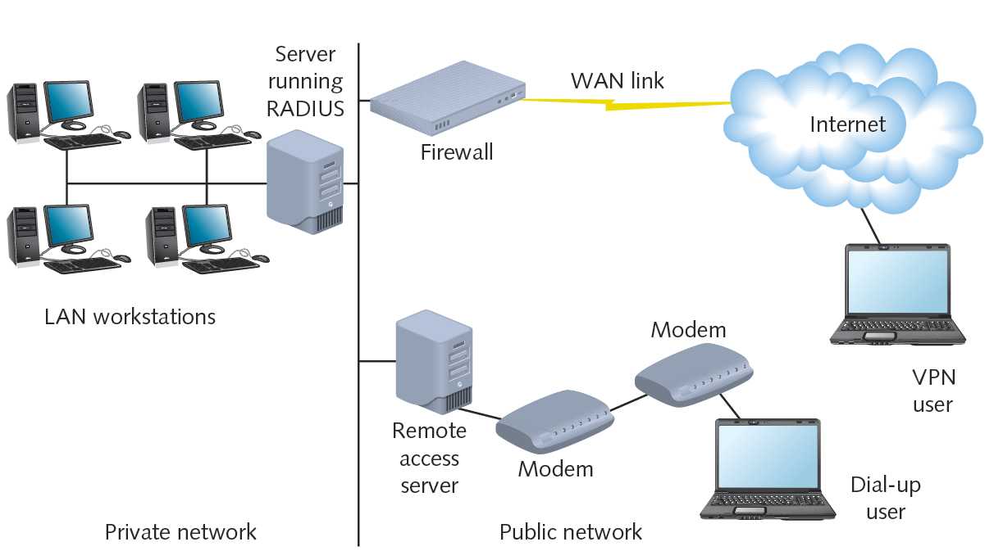
Figure 11-10 A RADIUS server on a network
Courtesy Course Technology/Cengage Learning

Slide 72
RADIUS and TACACS+ (cont’d.)
TACACS+ (Terminal Access Controller Access Control System Plus)
Separate access, authentication, and auditing capabilities
Differences from RADIUS
Relies on TCP at the Network layer
Proprietary protocol developed by Cisco Systems, Inc.
Typically installed on a router

Slide 73
PAP (Password Authentication Protocol)
PPP does not secure connections
Requires authentication protocols
PAP authentication protocol
Operates over PPP
Uses two-step authentication process
Simple
Not secure
Sends client’s credentials in clear text

Slide 74
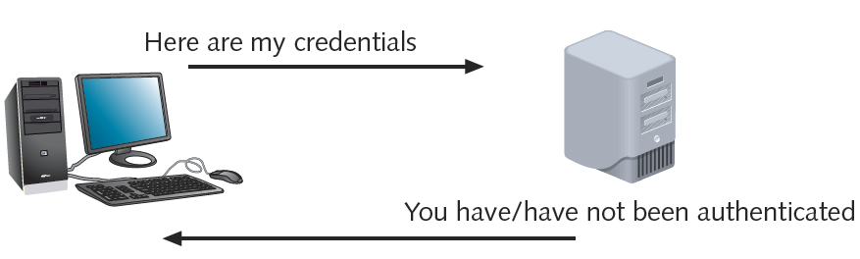
Figure 11-11 Two step authentication used in PAP
Courtesy Course Technology/Cengage Learning

Slide 75
CHAP and MS-CHAP
CHAP (Challenge Handshake Authentication Protocol)
Operates over PPP
Encrypts user names, passwords
Uses three-way handshake
Three steps to complete authentication process
Benefit over PAP
Password never transmitted alone
Password never transmitted in clear text

Slide 76
CHAP and MS-CHAP (cont’d.)
MS-CHAP (Microsoft Challenge Authentication Protocol)
Used on Windows-based computers
CHAP, MS-CHAP vulnerability
Eavesdropping could capture character string encrypted with password, then decrypt

Slide 77
CHAP and MS-CHAP (cont’d.)
MS-CHAPv2 (Microsoft Challenge Authentication Protocol, version 2)
Uses stronger encryption
Does not use same encryption strings for transmission, reception
Requires mutual authentication
Both computers verify credentials of the other

Slide 78
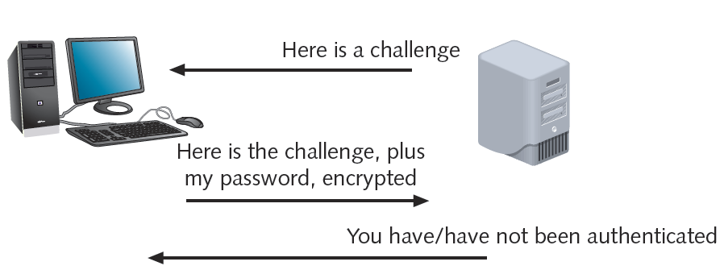
Figure 11-12 Three-way handshake used in CHAP
Courtesy Course Technology/Cengage Learning

Slide 79
EAP (Extensible Authentication Protocol)
Another authentication protocol
Operates over PPP
Works with other encryption and authentication schemes
Verifies client, server credentials
Requires authenticator to initiate authentication process
Ask connected computer to verify itself
EAP’s advantages: flexibility, adaptability

Slide 80
802.1x (EAPoL)
Codified by IEEE
Specifies use of one of many authentication methods plus EAP
Grant access to and dynamically generate and update authentication keys for transmissions to a particular port
Primarily used with wireless networks
Originally designed for wired LAN
EAPoL (EAP over LAN)
Only defines process for authentication
Commonly used with RADIUS authentication

Slide 81
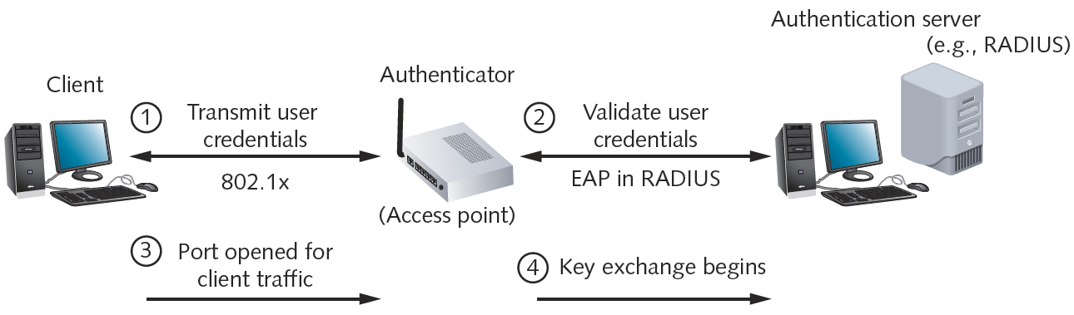
Figure 11-13 802.1x authentication process
Courtesy Course Technology/Cengage Learning

Slide 82
Kerberos
Cross-platform authentication protocol
Uses key encryption
Verifies client identity
Securely exchanges information after client logs on
Private key encryption service
Provides significant security advantages over simple NOS authentication

Slide 83
Kerberos (cont’d.)
Terms
KDC (Key Distribution Center)
AS (authentication service)
Ticket
Principal
Single sign-on
Single authentication to access multiple systems or resources
Two-factor authentication
Example: token and password

Slide 84
Wireless Network Security
Wireless transmissions
Susceptible to eavesdropping
War driving
Effective for obtaining private information
War chalking
Marking symbols to publicize access point SSID, secured status

Slide 85
WEP (Wired Equivalent Privacy)
802.11 standard security
None by default
Access points
No client authentication required prior to communication
SSID: only item required
WEP
Uses keys
Authenticates network clients
Encrypts data in transit

Slide 86
WEP (cont’d.)
Network key
Character string required to associate with access point
WEP implementations
First: 64-bit keys
Current: 128-bit, 256-bit keys
WEP flaws

Slide 87
IEEE 802.11i and WPA (Wi-Fi Protected Access)
802.11i uses 802.1x (EAPoL)
Authenticate devices
Dynamically assign every transmission its own key
Relies on TKIP
Encryption key generation, management scheme
Uses AES encryption
WPA (Wi-Fi Protected Access)
Subset of 802.11i
Same authentication as 802.11i
Uses RC4 encryption

Slide 88
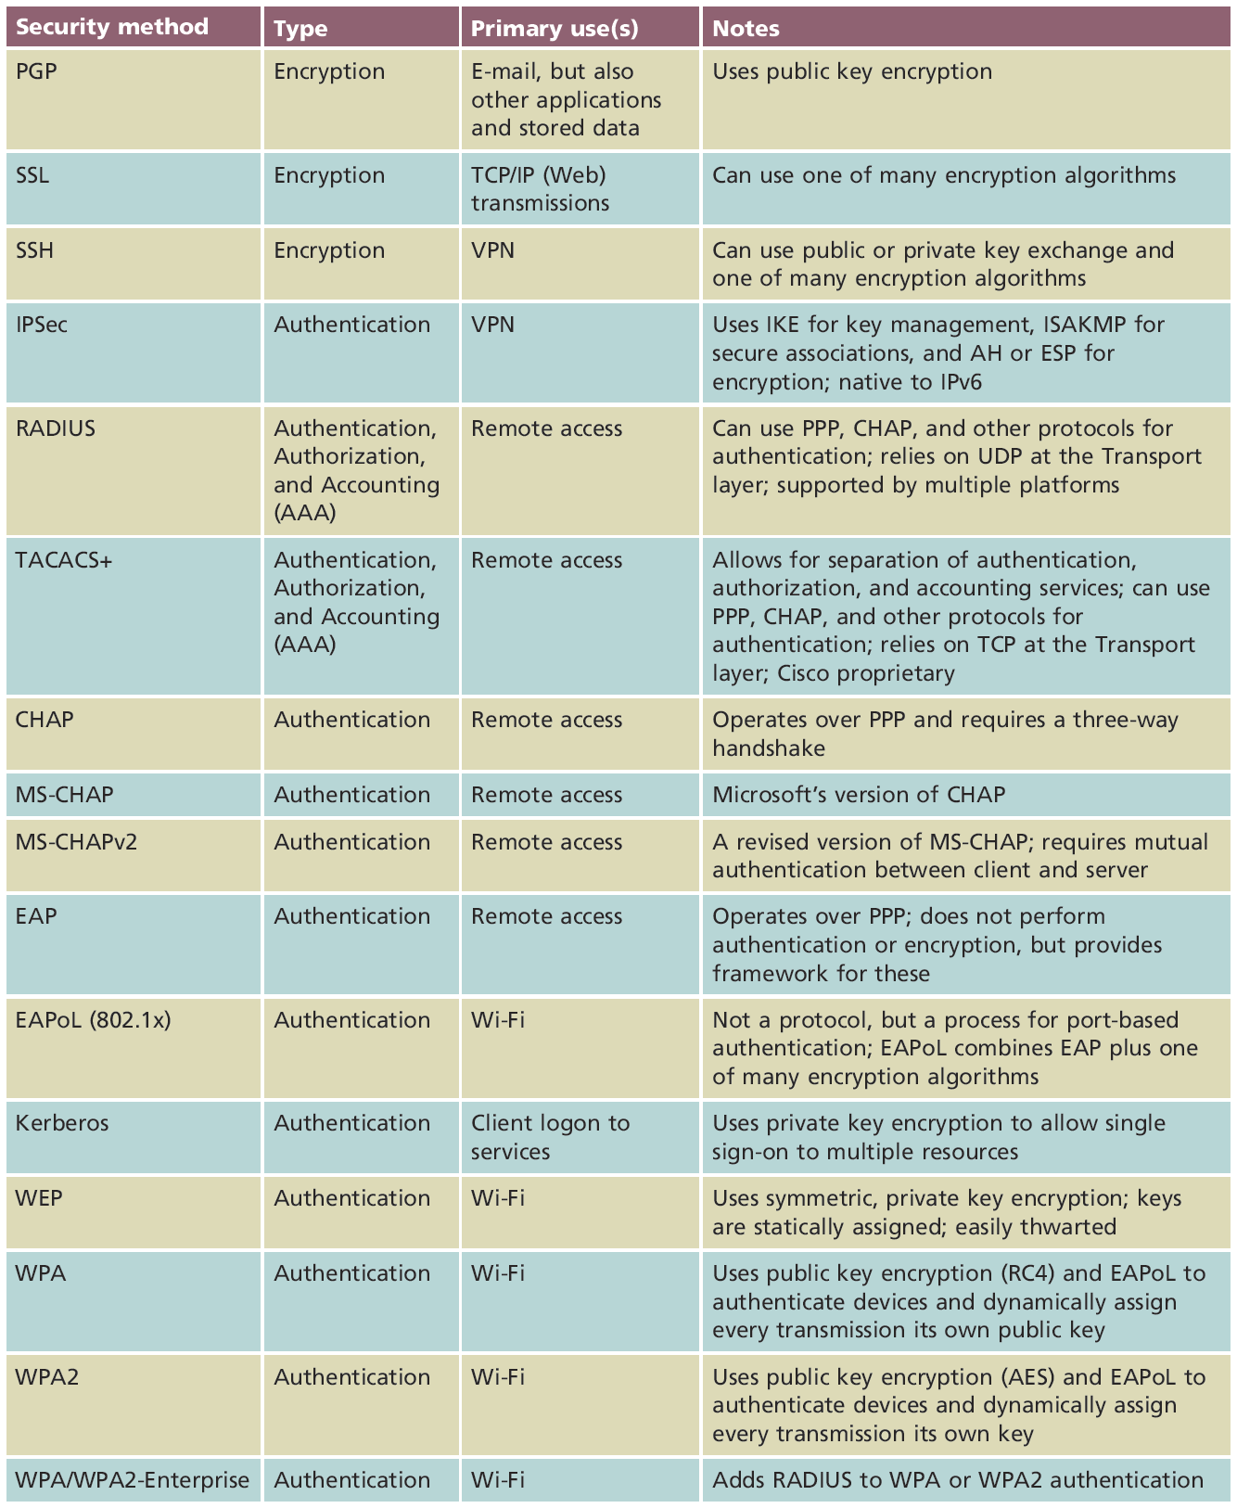
Table 11-1 Notable encryption and authentication methods
Courtesy Course Technology/Cengage Learning

Slide 89
Summary
Posture assessment used to evaluate security risks
Router’s access control list directs forwarding or dropping packets based on certain criteria
Intrusion detection and intrusion prevention systems used to monitor, alert, and respond to intrusions
Firewalls selectively filter or block traffic between networks
Various encryption algorithms exist
TKIP: a better wireless security solution than WEP

